Slide 1
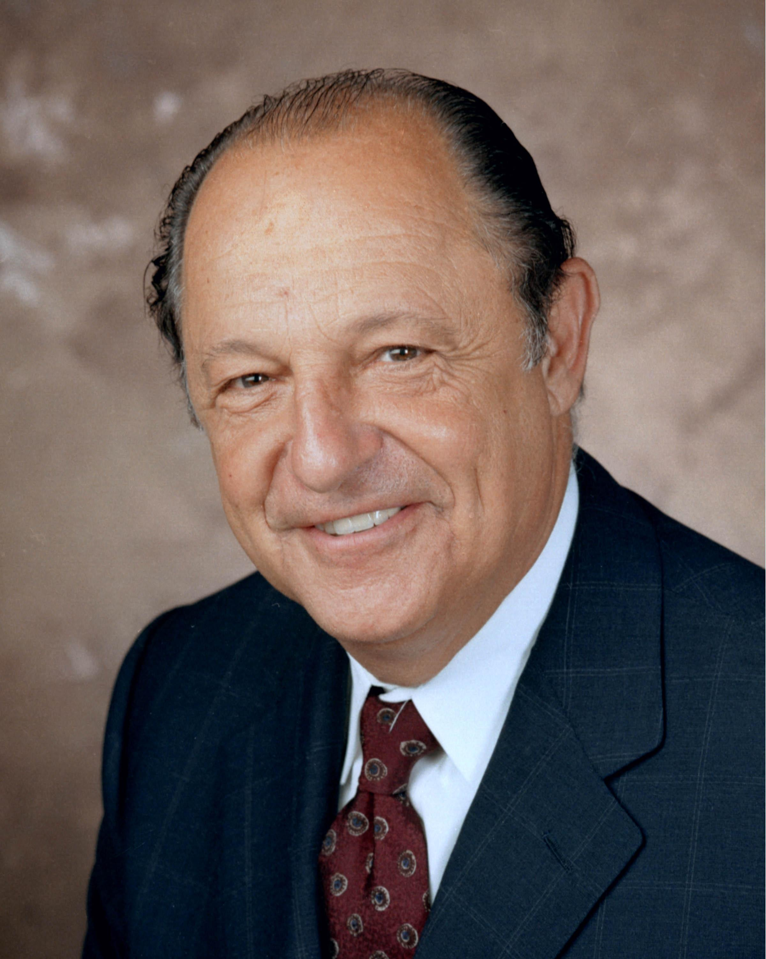
A NEW CAUSE OF DIABETES THAT AFFECTS ~1.25 MİLLİON AMERICANS: WHO WOUDA THOUGHT?
Ralph A. DeFronzo, MD
Professor of Medicine
Chief, Diabetes Division
UT Health San Antonio
and
Deputy Director
Texas Diabetes Institute

Slide 2
CONFLICT OF INTEREST
Boehringer-Ingelheim, Astra Zeneca, 89Bio, Amgen, Medality, CORCEPT
Grants:
Speakers Bureau:
Astra Zeneca, CORCEPT,
Advisory Board:
Astra Zeneca, Novo Nordisk, Boehringer Ingelheim, Intarcia, Aardvark, Renalytx, CORCEPT, Alnylam

Slide 3
CUSHING’S SYNDROME MASQUERADING AS T2DM: PATHOPHYSIOLOGIC CONSIDERATIONS
Ralph A. DeFronzo, MD
Professor of Medicine
Chief, Diabetes Division
UT Health San Antonio
and
Deputy Director
Texas Diabetes Institute

Slide 4
GLYCEMIC CONTROL IN T2DM: HOW WELL ARE WE DOING?

Slide 5
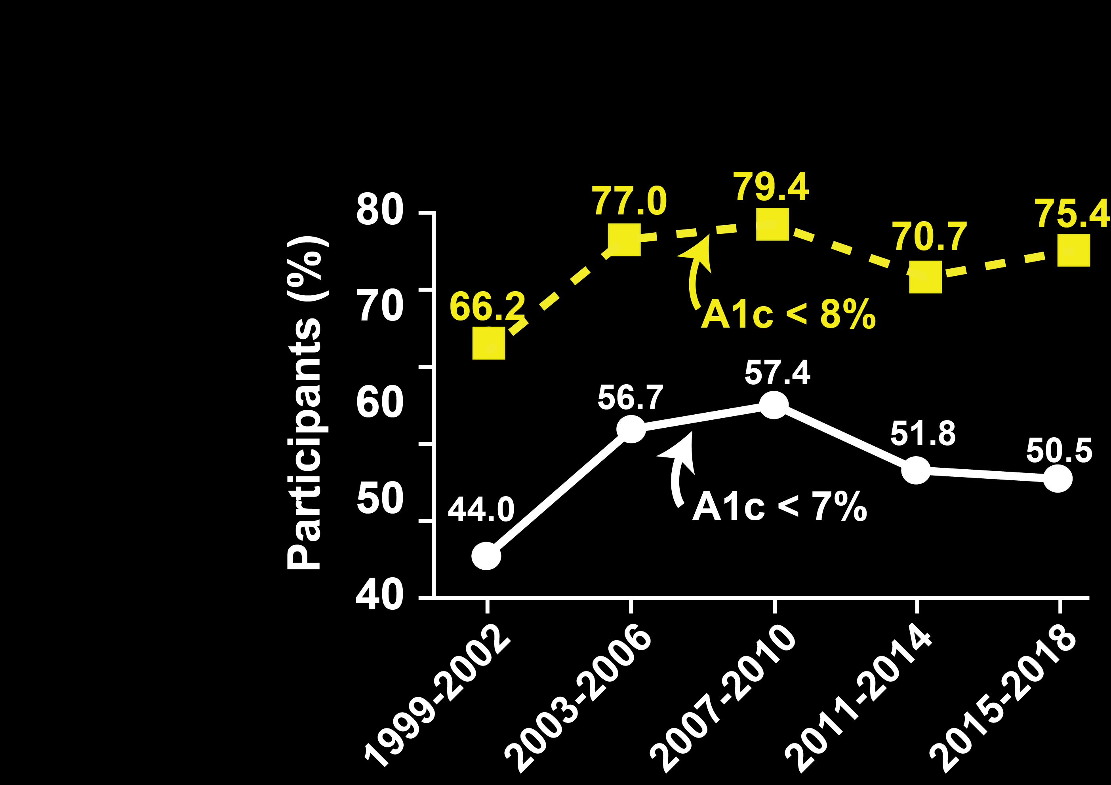
GLYCEMIC CONTROL (HbA1c) IN NHANES DIABETES PARTICIPANTS FROM 1999-2018
Fang et al, NEJM 384: 2219-2228, 2021

Slide 6
HYPERGLYCEMIA SECONDARY TO HYPERCORTISOLISM: A COMMONLY MISSED DIAGNOSIS OF DIFFICULT-TO-TREAT T2DM

Slide 7
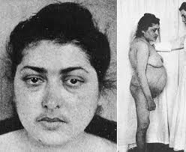
SOME PATIENTS WITH HYPERCORTISOLISM PRESENT WITH CLASSIC PHENOTYPIC FEATURES OF CUSHING SYNDROME^{1,2}
Easy bruising
Facial plethora
Proximal myopathy (or proximal muscle weakness)
Striae (especially of reddish purple and >1 cm wide)
Dorsocervical fat pad (“buffalo hump”)
Facial fullness
Obesity
Supraclavicular fullness
Acne
Hirsutism
Original publication: Bulletin of the Johns Hopkins Hospital, 1932. Reprint: Obes Res, 1994. Accessed November 21, 2022. doi:10.1002/j.1550-8528.1994.tb00097.x

Slide 8
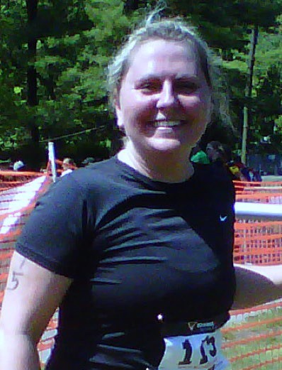
MOST PATIENTS WITH HYPERCORTISOLISM PRESENT WITHOUT CLASSIC PHENOTYPIC FEATURES^{1,2}: BIG FOUR
Easy bruising
Facial plethora
Proximal myopathy (or proximal muscle weakness)
Stria (especially of reddish purple and >1 cm wide)
Dorsocervical fat pad (“buffalo hump”)
Facial fullness
Obesity
Supraclavicular fullness
Acne
Hitsutism
Type 2 Diabetes
Hypertension
Obesity
Osteoporosis/ Fractures

Slide 9
CATALYST TRIAL
Subjects:
1,055 T2DM with A1c = 7.5-11.5%
≥ 3 anti-hyperglycemic drugs
insulin and any other antihyperglycemic drug
≥ 2 anti-hyperglycemic drugs plus ≥ 1 micro- or
macrovascular complication
≥ 2 anti-hyperglycemic and ≥ 2 antihypertensive
drugs
Methods:
1 mg –Dexamethasone Suppression Test (DST) with 1.8 ug/dl cortisol cut point
Dexamethosone > 140 mg/dl
ACTH – low
DHEAS – low
Adrenal CT scan
Mifepristone Treatment:
Primary endpoint = Change in A1c

Slide 10
CATALYST: STUDY DESIGN
1-mg overnight DST
Further evaluation
Hypercortisolism
Post-DST cortisol >1.8 μg/dL with dexamethasone ≥140 ng/dL
Labs (ACTH, DHEAS, cortisol)
Adrenal CT scan
Persons with difficult-to-control T2D (n~1000)
Refer those requiring evaluation for elevated ACTH for care outside the study
Primary endpoint
Prevalence of hypercortisolism
Key secondary endpoints
Clinical characteristics of participants with hypercortisolism
Percentage of participants with hypercortisolism with/without abnormal adrenal CT scan
Clinical/laboratory characteristics of participants with hypercortisolism with/without abnormal adrenal CT scan

Slide 11
PREVALENCE OF HYPERCORTISOLISM IN CATALYST
253 of 1055 CATALYST participants screened have hypercortisolism
Percent (%)
Post-DST cortisol: 3.5 μg/dL
Post-DST dexamethasone: 413 ng/dL

Slide 12
24% of poorly controlled T2D patients with A1c > 7.5% on multiple oral hypoglycemic agents ± insulin have hypercortisolism
CATALYST TRIAL
Approximately 1 in 3 have an adrenal adenoma

Slide 13
IN CATALYST ~ 1 OF 4 PATIENTS WITH DIFFICULT-TO-CONTROL T2D HAD ENDOGENOUS HYPERCORTISOLISM
24% (N=253/1055) OF T2D PARTICIPANTS HAD HYPERCORTISOLISM
24%
Dexamethasone Suppression Test (1mg) AM Plasma Cortisol >1.8ug/dl and dexamethasone ≥140ng/dl
76%
34% had an adrenal abnormality

Slide 14
ADRENAL IMAGING ABNORMALITY DOCUMENTED IN ONE-THIRD OF CATALYST PARTICIPANTS WITH HYPERCORTISOLISM
Other adrenal abnormality
Unilateral/bilateral adrenal enlargement,
Bilateral adrenal adenomas
27.1%
Unilateral adrenal adenoma
Potential surgical targets
No imaging abnormality reported

Slide 15
PARTICIPANTS WITH HYPERCORTISOLISM HAD MORE CARDIOVASCULAR DISEASE
Any Cardiac Disorders
Coronary Artery Disease
Atrial Fibrillation
Heart Failure
P=0.004
Percent (%)
Patients with T2D are at higher CVD risk, and this risk appears to increase further in those who also have hypercortisolism
Post-DMS Cortisol < 1.8mg/dl
Post-DMS Cortisol > 1.8mg/dl

Slide 16
CATALYST PARTICIPANTS WITH HYPERCORTISOLISM
HAD MORE RESISTANT HYPERTENSION
P < 0.01
20 -
17.7%
15 -
Percent (%)
10 -
8.5 %
5 -
0 -
Post-DMS
Cortisol < 1.8
Post-DMS
Cortisol > 1.8

Slide 17
PREVALENCE OF HYPERGLYCEMIA SECONDARY TO HYPERCORTISOLISM
40 million Americans have T2DM
~25% have A1c > 8.0%
10 million Americans
~50% are on > 2-3 OHAs
± insulin
5 million Americans
~25% have hypercortisolism
1,125,000 Americans

Slide 18
SCREENING FOR HYPERCORTISOLISM IN DIFFICULT-TO-TREAT T2D
OVERNIGHT DEXAMETHASONE (1 mg) SUPPRESSION TEST (DMS)
Cortisol < 1.8 ug/dL; Dexamethasone >140 ng/dL
Urinary free cortisol – often normal
Late night salivary cortisol
– poor specificity; cumbersome
ACTH – low/low normal (supportive)
– excludes pituitary/ectopic Cushing
DHEAS – low (supportive)

Slide 19
PATIENT POPULATIONS WITH THE FOLLOWING MANIFESTATIONS SHOULD BE SCREENED FOR HYPERCORTISOLISM
Difficult-to-control T2DM
Resistant hypertension
Adenomas
Poorly controlled T2DM despite medications and appropriate diet
Combination of poorly controlled T2DM and hypertension
Onset of T2DM at <40 years of age without family history and/or β-cell autoimmunity
Grade 3 or resistant hypertension
Sudden new onset/unexpected worsening of hypertension
Onset of hypertension at <30 years of age without family history
Adrenal incidentalomas
Pituitary incidentalomas and fragility fractures, T2DM, and/or hypertension

Slide 20
HOW DOES HYPERCORTISOLISM CAUSE HYPERGLYCEMIA?

Slide 21
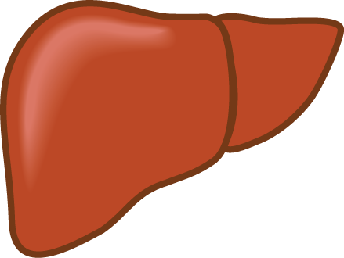
THE TRIUMVIRATE
Impaired Insulin Secretion
Hyperglycemia
Increased
HGP
Decreased Glucose
Uptake
DeFronzo RA, Diabetes 37:667-687, 1988

Slide 22
INSULIN-STIMULATED MUSCLE GLUCOSE UPTAKE
Insulin
Glucose
Akt
PI3K
IRS-1
GLUT 4
Pyruvate
Glycogen Synthase
Pyruvate
deHase
AcCoA
Glycogen
KREBS
Cycle

Slide 23
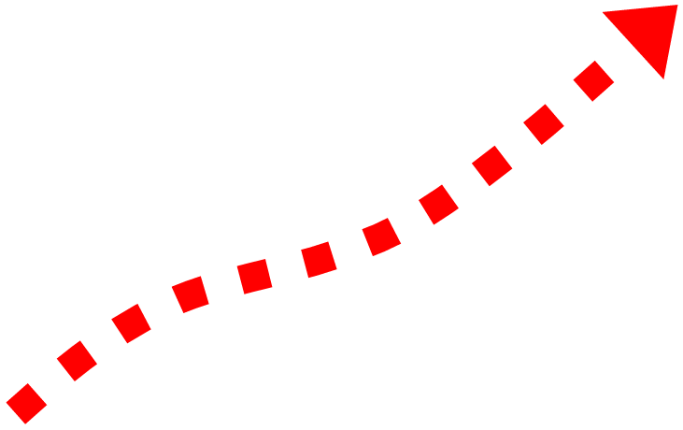
GLUCOCORTICOID-INDUCED MUSCLE INSULIN RESISTANCE
Insulin
Glucose
Akt
-
PI3K
IRS-1
-
-
GC Receptor
GLUT 4
-
Pyruvate
Glycogen Synthase
Pdk4
Pyruvate
deHase
AcCoA
Glycogen
KREBS
Cycle
Gluco-
corticoids

Slide 24
GLUCOCORTICOIDS PROMOTE MUSCLE ATROPHY
Insulin
IGF-1
Amino Acids
Akt
PI3K
IRS-1
Protein
Synthesis
GC Receptor
-
PROTEIN
CATABOLISM
+
Protein
Degradation
Gluco-
corticoids
Sites of Gluco- corticoid action

Slide 25
GLUCOCORTICOIDS PROMOTE MUSCLE ATROPHY
Insulin
IGF-1
Amino Acids
Akt
PI3K
IRS-1
Protein
Synthesis
GC Receptor
-
MUSCLE ATROPHY
+
Protein
Degradation
Myo-
statin
Gluco-
corticoids
ACTIVIN
RECEPTORS
Sites of Gluco- corticoid action

Slide 26
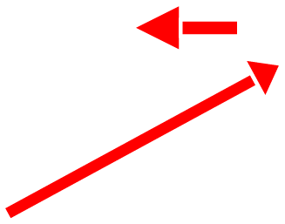
GLUCOCORTICOID-INDUCED MUSCLE INSULIN RESISTANCE
Insulin
Akt
-
PI3K
IRS-1
-
-
-
-
GLUT 4
Pyruvate
Glycogen Synthase
Pyruvate
deHase
-
AcCoA
Glycogen
KREBS
Cycle
FA-C
FFA
FA-C
Glycerol
FA-C
+
Lipase
GLUT 4
GC
-
ADIPOCYTE

Slide 27
THE TRIUMVIRATE
Impaired Insulin Secretion
Hyperglycemia
Increased
HGP
Decreased Glucose
Uptake
DeFronzo RA, Diabetes 37:667-687, 1988

Slide 28
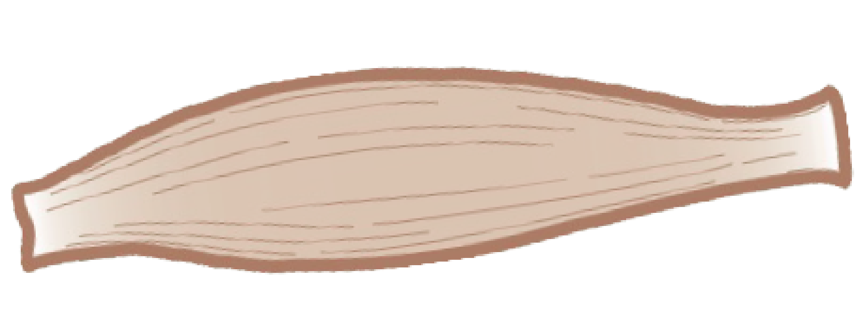
REGULATION OF HEPATIC GLUCONEOGENESIS: CORI CYCLE (LACTATE) AND CAHILL (ALANINE) CYCLE
GLUCOSE
G6Pase
LIVER
PEP-CK = Phosphoenol- pyruvate carboxykinase
G6P
GLYCOGEN
PC = Pyruvate carboxylase
PEP
PEP-CK
OAA
PC
Alanine
Alanine
Pyruvate
Protein
Lactate
Lactate
Glycogen

Slide 29
GLUCOCORTICOIDS STIMULATE HEPATIC GLUCONEOGENESIS
GLUCOSE
Sites of Gluco- corticoid action
G6Pase
LIVER
PEP-CK = Phosphoenol- pyruvate carboxykinase
G6P
GC Receptor
PC = Pyruvate
carboxykinase
PEP
PEP-CK
Gluco-
corticoids
OAA
PC
Alanine
Alanine
Pyruvate
Protein
Lactate
Lactate
Glycogen

Slide 30
THE TRIUMVIRATE
Impaired Insulin Secretion
Hyperglycemia
Increased
HGP
Decreased Glucose
Uptake
DeFronzo RA, Diabetes 37:667-687, 1988

Slide 31
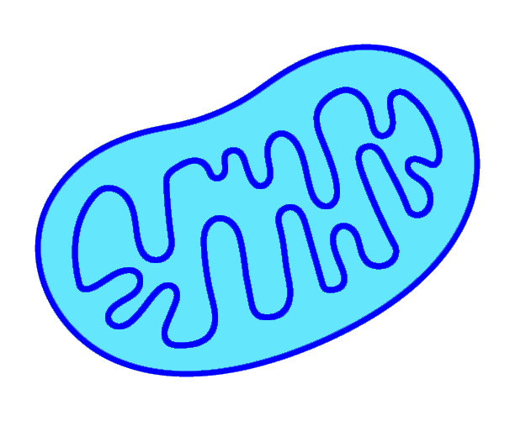
GLUCOSE-STIMULATED INSULIN SECRETION
Van Raalte DH et al, Eur J Clin Invest 39:81-94, 2009
Eriksen et al, Diabetologia 58:920-928, 2015
Glucose
GK
ATP
G6P
ATP
K⁺ ATPase
GLP-1
GIP
AC
Pyruvate
Depolarization
CAMP
Ca⁺⁺
Ca⁺⁺
Ca⁺⁺
Channel
Amplifies
Insulin
Exocytosis

Slide 32
CHRONIC GLUCOCORTICOID EXPOSURE IMPAIRS INSULIN SECRETION
Van Raalte DH et al, Eur J Clin Invest 39:81-94, 2009
Eriksen et al, Diabetologia 58:920-928, 2015
Sites of Gluco- corticoid action
Gluco-
corticoids
Glu2
Glucose
GC Receptor
GK
ATP
G6P
ATP
K⁺ ATPase
GLP-1
GIP
AC
Pyruvate
Depolarization
CAMP
Ca⁺⁺
Ca⁺⁺
Ca⁺⁺
Channel
Amplifies
Insulin
Exocytosis

Slide 33
EFFECT OF DEXAMETHASONE ON INS-1 CELL DEATH (TUNEL ASSAY) AND APOTOTIC MARKERS (CASPASE-3 ACTIVITY)
Ranta F et al, Diabetes 55:1380-90, 2006
8 -
P<0.001
P<0.001
- 100
6 -
- 75
Tunel Assay
(% Fractionated Nuclei)
Caspase-3 Activity
(μmol/mg protein)
4 -
- 50
2 -
- 25
0 -
- 0
Control
Dexameth-
asone
Dexa +
Exendin-4
Control
Dexameth-
asone
Dexa +
Exendin-4

Slide 34
SUMMARY
ADIPOCYTE
Lipolysis
GUT
Glucose
Uptake
LIVER
GLP-1/GIP
Gluco- neogenesis
Lipogenesis
(DNL)
GLUCO-CORTICOIDS
Glucose
Uptake/Oxidation
Insulin Sectetion
GLP-1 Resistance
Glycogen
Synthesis
Glucagon Sectetion
Protein
Degradation
PANCREAS
muscle

Slide 35
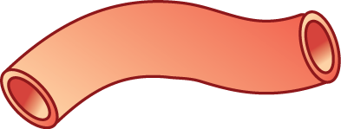
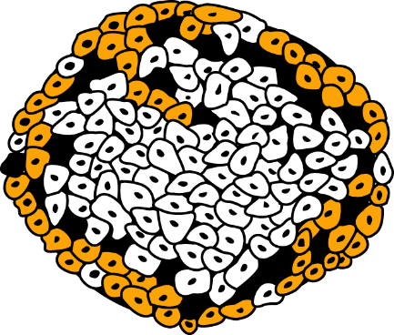
OMINOUS OCTET
Decreased Incretin Effect
Decreased Insulin Secretion
Increased
Lipolysis
Islet–α cell
HYPERGLYCEMIA
Increased
Glucose
Reabsorption
Increased Glucagon Secretion
Increased
HGP
Decreased Glucose
Uptake
Neurotransmitter Dysfunction
Diabetes 58:773-795, 2009

Slide 36
OMINOUS OCTET
Decreased Incretin Effect
Decreased Insulin Secretion
Increased
Lipolysis
Islet–α cell
HYPERGLYCEMIA
Increased
Glucose
Reabsorption
Increased Glucagon Secretion
Increased
HGP
Decreased Glucose
Uptake
Neurotransmitter Dysfunction
Diabetes 58:773-795, 2009

Slide 37
THE NOXIOUS NINE
Decreased Incretin Effect
Decreased Insulin Secretion
Increased
Lipolysis
Islet–α cell
HYPER-
CORTISOLISM
HYPERGLYCEMIA
Increased
Glucose
Reabsorption
Increased Glucagon Secretion
Increased
HGP
Decreased Glucose
Uptake
Neurotransmitter Dysfunction

Slide 38
EPIDEMIOLOGY OF HYPERTENSION IN CUSHING’S SYNDROME (CS)
Hypertension occurs in 80-85% of individuals with Cushing’s Syndrome and, as a clinical feature, is second only to weight gain/obesity
Systolic and diastolic blood pressure are increased in parallel; males and females are equally affected
Mortality is 2.5-5 fold increased in untreated CS in patients with hypertension and/or type 2 diabetes
Pathogenesis is poorly understood but eventuates in vascular rearrangement and fibrosis
Barbot et al, Front Endo 10:1-9, 2019; Li et al, Gland Surg 9:43-58, 2019; Isidori et al, J Hyperten 33:44-60, 2015; Fallo et al, J Hyperten 40:2085-2101, 2022

Slide 39
MECHANISM OF HYPERTENSION IN CUSHING’S SYNDROME
(1) Activation of mineralocorticoid and glucocorticoid receptors
(2) Renin-angiotensin system
(3) Sympathetic nervous system
(4) Imbalance between vasodilators and vasoconstrictors
(5) Obstructive sleep apnea syndrome (OSAS)
(6) Direct effect of cortisol on the arterial vasculature

Slide 40
HYPERCORTISOLISM AND HYPERTENSION
Cortisol and aldosterone have similar binding affinity to the mineralocorticoid receptor
Cortisol binding to mineralocorticoid receptor salt and water retention
Cortisol binding to glucorticoid receptor
activates renal epithelial sodium
channel (ENaC)

Slide 41
MECHANISM OF HYPERTENSION IN CUSHING’S SYNDROME
(1) Activation of mineralocorticoid and glucocorticoid receptors
(2) Renin-angiotensin system
(3) Sympathetic nervous system
(4) Imbalance between vasodilators and vasoconstrictors
(5) Obstructive sleep apnea syndrome (OSAS)
(6) Direct effect of cortisol on the arterial vasculature

Slide 42
PHARMACOLOGIC TREATMENT OF COMORBIDITIES WITHOUT TREATING HYPERCORTISOLISM IS INEFFECTIVE AT REDUCING LONG-TERM GLOBAL CARDIOVASCULAR EVENTS
Cumulative Risk (%)
Petramala L, et al. Endocrine. 2020;70(1):150-163.
50
HR=2.56
P<0.001
Pharmacologic comorbidity management
(n=118)
40
30
Surgical intervention
(n=29)
20
Nonfunctioning adenoma
(N=471)
10
0
0
5
10
15
Years
Patients with adrenal autonomous cortisol secretion who do not receive treatment targeting their hypercortisolism are at increased risk for future CV events and CV mortality

Slide 43
PHARMACOLOGIC TREATMENT OF COMORBIDITIES WITHOUT TREATING HYPERCORTISOLISM IS INEFFECTIVE AT REDUCING LONG-TERM CARDIOVASCULAR SURVIVAL
Petramala L, et al. Endocrine. 2020;70(1):150-163.
Logarithmic Cumulative Survival
0
–1
Nonfunctioning
(n=421)
–2
Surgical intervention
(n=29)
–3
Pharmacologic comorbidity management
(n=118)
HR=2.64
P<0.001
–4
–5
0
5
10
15
Years
Patients with adrenal autonomous cortisol secretion who do not receive treatment targeting their hypercortisolism are at increased risk for future CV events and CV mortality

Slide 44
OBSTRUCTIVE SLEEP APNEA SYNDROME (OSAS) AND CUSHING’S SYNDROME
OSAS is commonly associated with resistant hypertension
30-40% of patients with Cushing’s Syndrome have OSAS
Cushing’s Syndrome and OSAS both are characterized by activation of the SNS and altered cortisol circadian rhythm
Unfortunately, the results of continuous positive airway pressure on BP have been unimpressive
Parati G et al, J Hypertension 32:633-46, 2012; Bottini P et al, Respiration 70:320-27, 2003; Schein AS et al, J Hypertension 32:1762-73, 2014

Slide 45
TREATMENT OPTIONS
(1) Surgical removal of adrenal adenoma
(2) Surgical removal of pituitary or ectopic ACTH-secreting tumor
(3) Pharmacologic management of comorbidities
hypertension, hyperglycemia, dyslipidemia
(4) Glucocorticoid receptor antagonists
mifepristone (Korlym)
relacorilant
(5) Adrenal steroidogenesis inhibitors
ketoconazole, levoketaconazole (17-α-hydroxylase inhibitor)
metyrapone, osilodrostat (11-β-hydroxylase inhibitor)
Mitotane (adrenolytic)

Slide 46
SUMMARY
Hypercortisolism prevalence was 24.0% among the 1055 CATALYST participants
Baseline characteristics that increased odds of having hypercortisolism:
higher medication burden for hypertension, lipids, and
psych disease
presence of cardiovascular disease
Abdominal CT scan revealed an adrenal abnormality in one-third of participants with hypercortisolism
Screening is easy: 1 mg DST
Part 2 of CATALYST will assess whether medical treatment of hypercortisolism is beneficial in these patients

Slide 47
TAKEAWAY MESSAGES
CALL TO ACTION: Clinicians need to screen for hypercortisolism
High level of suspicion: BIG FOUR
difficult to treat hyperglycemia
refractory hypertension
obesity (esp recent weight gain)
fractures, osteopenia
Screening: 1 mg dexamethasone suppression test
Treatment: medical management; surgical removal of adenoma; glucocorticoid receptor antagonists (mifepristone, relacorilant), steroidogenesis inhibitors)

Slide 48
OMINOUS OCTET
Decreased Incretin Effect
Decreased Insulin Secretion
Increased
Lipolysis
Islet–α cell
HYPERGLYCEMIA
Increased
Glucose
Reabsorption
Increased Glucagon Secretion
Increased
HGP
Decreased Glucose
Uptake
Neurotransmitter Dysfunction
Diabetes 58:773-795, 2009

Slide 49
THE NOXIOUS NINE
Decreased Incretin Effect
Decreased Insulin Secretion
Increased
Lipolysis
HYPER-
CORTISOLISM
Islet–α cell
HYPERGLYCEMIA
Increased
Glucose
Reabsorption
Increased Glucagon Secretion
Increased
HGP
Decreased Glucose
Uptake
Neurotransmitter Dysfunction

Slide 50
THANK YOU!

Slide 51
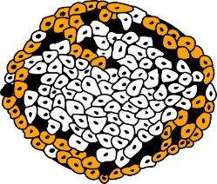
EXCESS CORTISOL IMPAIRS GLUCOSE METABOLISM AND IMPACTS TISSUE AND ORGANS THAT ANTIDIABETIC MEDICATIONS TARGET
GUT
β CELL
↓ ISLET sensitivity to GLP-1
↓ GLP-1 secretion
Fat cell
↓ β-cell function
β-cell apoptosis
↓ glucose disposal
↑ Lipolysis
Substrates for gluco- neogenesis
↑ Fatty acid levels impair glucose metabolism
↑ FFA impair insulin secretion
α CELL
HYPERGLYCEMIA
Glucagon secretion
Kidney
LIVER
Direct effects:
Gluconeogenesis
↑ Glycogenolysis
Glycogen synthesis
Indirect effects:
↓ Insulin sensitivity
↑ Glucagon sensitivity
↑ Glucagon secretion
↓ Glucose uptake
↓ Glycogen synthesis
↑ Proteolysis
↑ Substrates for gluconeogenesis
Circadian disruption of metabolism regulation
Neuropeptide secretion
MUSCLE
BRAIN

Slide 52
HIGHER LIKELIHOOD OF HYPERCORTISOLISM IN THOSE WITH HYPERGLYCEMIA PLUS HYPERTENSION OR MICRO-/MACROVASCULAR COMPLICATIONS
≥2 Anti-hyperglycemic + ≥2 anti-hypertension medications
≥2 Anti-hyperglycemic medications + ≥1 micro-/macrovascular complication
≥3 Anti-hyperglycemic medications
Insulin + any other anti- hyperglycemic medications
Odds ratio | 95% CI
1.87 | 1.4, 2.49
1.65 | 1.24, 2.20
1.35 | 0.984, 1.85
0.94 | 0.696, 1.28
0
0.5
1.0
1.5
2.0
2.5
Lower odds
Higher odds of hypercortisolism

Slide 53
HIGHER LIKELIHOOD OF HYPERCORTISOLISM IN THOSE TAKING NEWER CLASSES OF ANTI-HYPERGLYCEMIC MEDICATIONS
 |  |  | Odds ratio | 95% CI
Tirzepatide |  |  | 1.82 | 1.18, 2.79
SGLT2 inhibitors |  |  | 1.69 | 1.26, 2.25
GLP-1 analogues |  |  | 1.20 | 0.90, 1.59
Insulin |  |  | 1.00 | 0.73, 1.36
Sulfonylureas |  |  | 0.79 | 0.57, 1.10
Metformin |  |  | 0.78 | 0.57, 1.07
GLP-1 analogues + SGLT2 inhibitors |  |  | 1.47 | 1.08, 1.99
Insulin + SGLT2 inhibitors |  |  | 1.45 | 1.08, 1.94
Insulin + GLP-1 analogues + SGLT2 inhibitors |  |  | 1.38 | 0.97, 1.97
Insulin + GLP-1 analogues |  |  | 1.14 | 0.84, 1.54
≥4 Anti-hyperglycemic drugs |  |  | 1.19 | 0.87, 1.62
Greater number of anti-hyperglycemic medication classes |  |  | 1.21 | 1.05, 1.40
0
0.5
1.0
1.5
2.0
2.5
3.0
Lower odds
Higher odds of hypercortisolism

Slide 55
CHARACTERISTICS INDEPENDENTLY ASSOCIATED WITH HYPERCORTISOLISM
 | Odds ratio | P-value
Ethnicity: Non-Hispanic/Latino vs Hispanic/Latino | 4.47 | <0.0001
Fibrates (yes vs no) | 2.33 | 0.001
Tirzepatide (yes vs no) | 1.91 | 0.009
SGLT2 inhibitor (yes vs no) | 1.68 | 0.001
Body mass index <30 vs ≥30 kg/m² | 1.58 | 0.007
Race: White vs Non-White | 1.51 | 0.02
Analgesics (yes vs no) | 1.50 | 0.02
Greater number of antihypertensive medication classes | 1.39 | <0.0001
HbA1c (1% increase) | 1.29 | 0.001
Age (1 year increase) | 1.03 | 0.0003
0
1
2
3
4
5
6
7
Lower odds
Higher odds of hypercortisolism
Lower odds
Higher odds of hypercortisolism

